Slide 1
Prevention of Impersonation Using Face-recognition

Slide 2
Problem
Online software for prevention of impersonation via face recognition will be implemented for competative examinations. The aim of this system is to verify the candidate appeared for the exam with the photo submitted at the time of registration. This will help the exam cell authorities to easily verify the candidates.

Slide 3
Approach
Machine Learning
Web-developement
Database
Our solution capture video using webcam for that we are using opencv library. Which will process video as continuos image frames in for loop. And then using dlib (a machine learning library) for matching it with database image.
Our solution makes sure that this impersonation system can work simultaneously at multiple exam centers and will be taking the registration data from centralized server for candidate verification process.
Our database will be centralized one which will contain the student exam registration data. Which will be using for verifying candidates at the time exams

Slide 4
Challenges deep-dive
Challenge 1
Challenge 2
Challenge 3
Processing video as image frames.
Matching candidate face with database image using machine learning.
Providing the facility to simultaneous verification process at multiple exam centres using website. And user interface for administrator.

Slide 5
Implementation

Slide 6
Consists of 5 parts:
Video processing using Opencv
Providing simultaneous operation facility.
User Interface for adminstrator.
Matching of images.
Database handling.
Solution

Slide 7
Flow
Match the image captured through webcam with the image of corresponding candidate available in database which we will obtain using his roll no.
Entry will be done of the corresponding candidate into the database and faulty cases will be noted.
Take the roll no. of student by scanning the barcode on hall ticket.
Step 1
Step 2
Step 3
Step 4
Step 5
Capture the face of candidate through webcam and process these continuous video frames using Opencv library.
Audio output will be given whether the candidate’s face matches with the database image or not.

Slide 8
Control flow Chart

Slide 9




Technology Stack
Django (Web-framework)
Opencv and dlib (libaries)
Python3
MySQL database

Slide 10
Django (A Python web-framework)
Django is one of highest level Python web-framework.
Reassuringly secure : Django takes security very seriously and helps developers avoid many common security problems.
Ridiculously fast : Django was designed to help developers take application from concept to completion as quickly as possible.
Also it has its own pre-defined ways of doing the things called “the Django way” which ensures that you do the web things in the best possible way.

Slide 11
Dlib
Deep Learning

Slide 12
What is Dlib?
Dlib is a general purpose cross-platform software library written in the programming language C++
Dlib is a modern C++ toolkit containing machine learning algorithms and tools for creating complex software in C++ to solve real world problems
It contains machine learning, Image processing, Data mining etc.

Slide 13
Why Dlib?
Contains Deep Learning – Machine Learning algorithm.
Problems with machine learning-
High dimensionality
Feature Extraction

Slide 14
Deep Learning
Subset of machine learning using artificial neural networks.
Mimics human brain.
Supervised, Unsupervised, Semi-Supervised.
To identify individuals after getting input image.

Slide 15
OpenCV

Slide 16
OpenCV(Open Source Computer Vision Library)
It is an image processing library bindings with python, java, C++.
Input from webcam.
Does frames processing.
Runs the frames in loop as in case of video processing.

Slide 17
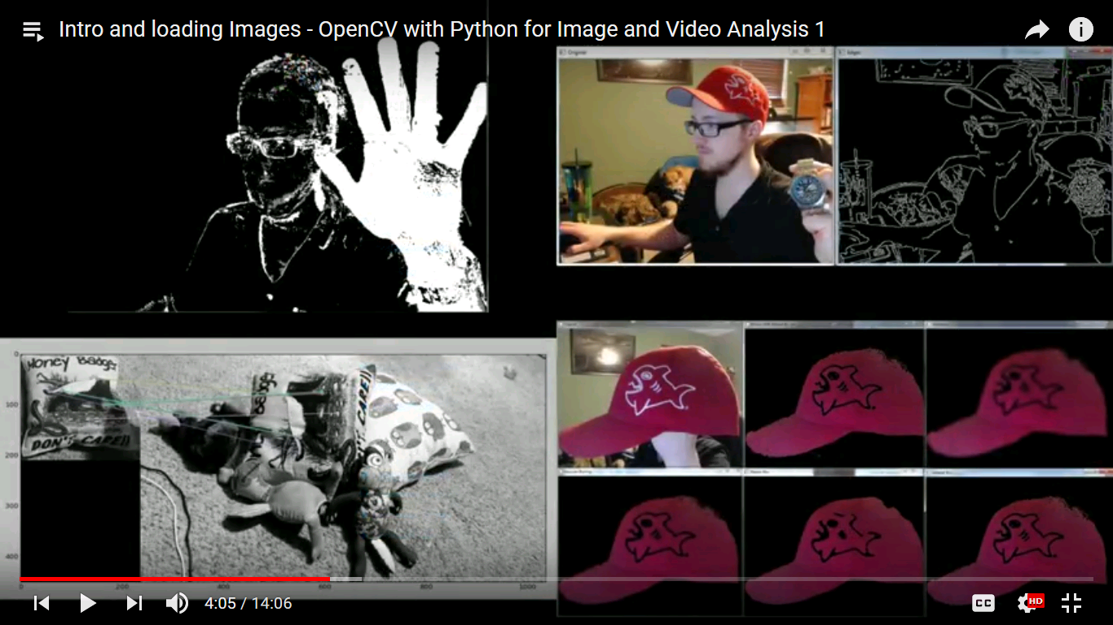
Background subtraction

Slide 18
Edge Detection

Slide 19
Identify objects which are placed at different angles

Slide 20
Applying filters only to specific range of colors

Slide 21
Future Scope
The system can be used to take attendance of class.
It can also be used at ATM centre to avoid defaulters.
It can also be used in case of parking(noting number plate).

